Slide 1
Senior Project
Final Presentation
Summer 2016
VIP 3.0 Team Member(s): Vladan Lalovic, Johnatan Jensen, Michael Martinez, Daniel Lopez Product Owner(s): Masoud Sadjadi, Mohsen Taheri, Maral Kargarmoakhar
School of Computing and Information Sciences Florida International University

Slide 2
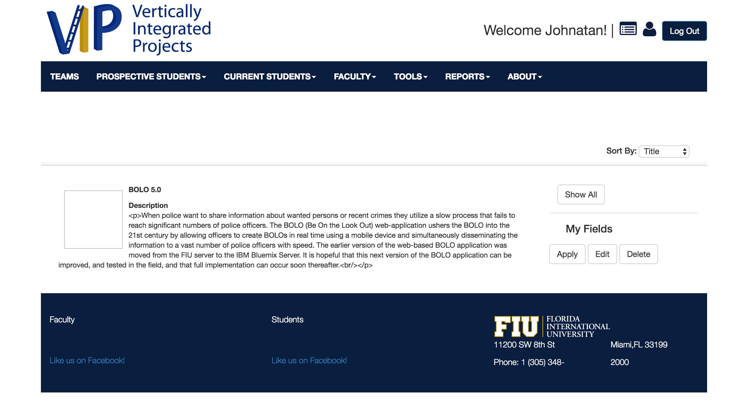
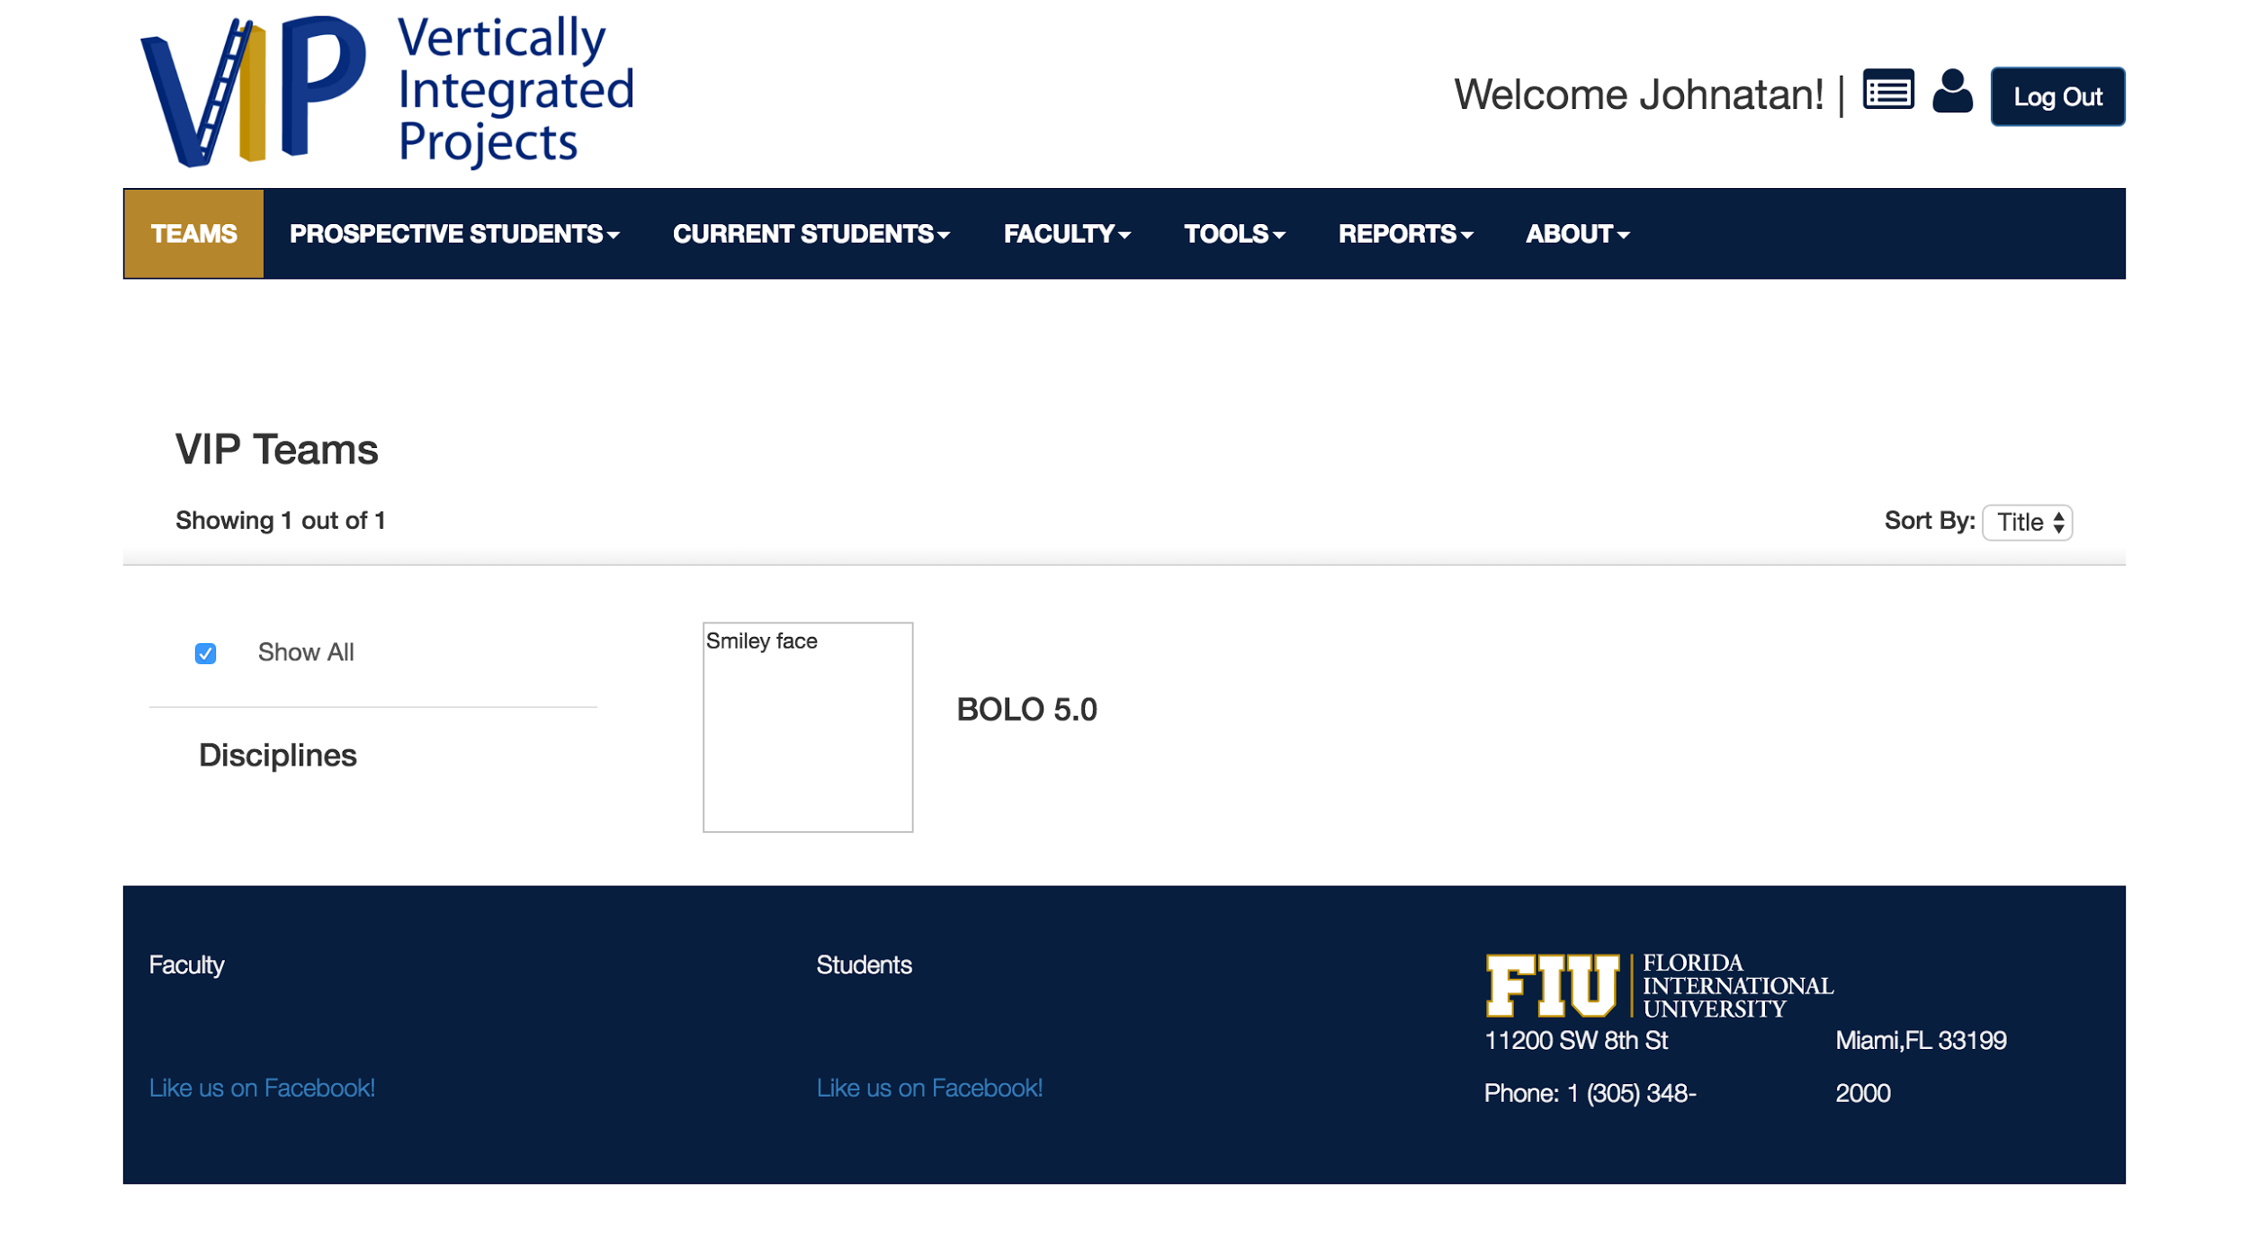
PROBLEMS OF VIP 2.0
Lacked main functionality
Mostly static
Not user friendly
No mobile responsiveness
Admin had no powers
Team focused on mobile judge

Slide 3
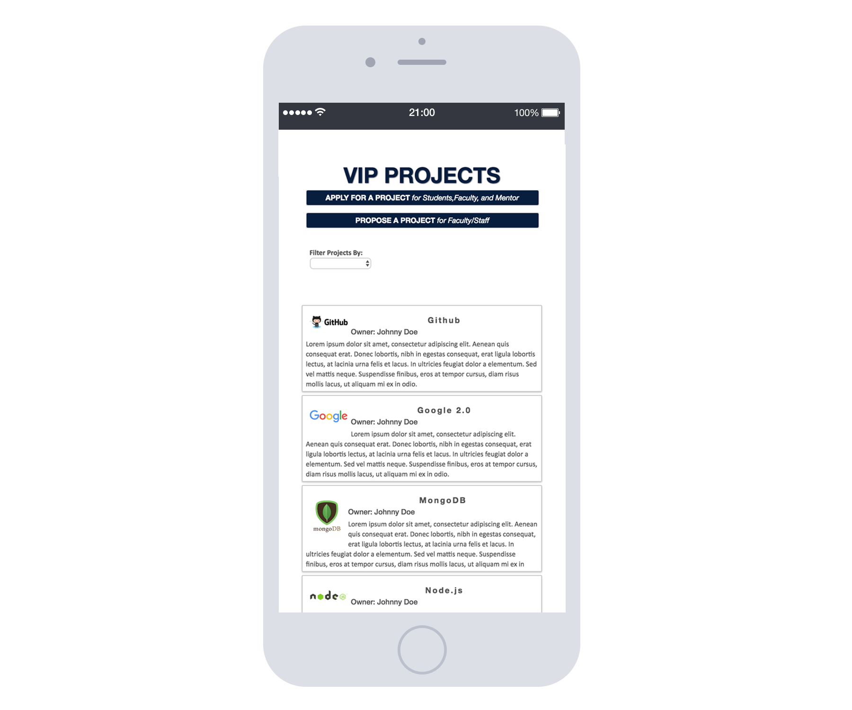
VIP TODAY

Slide 4
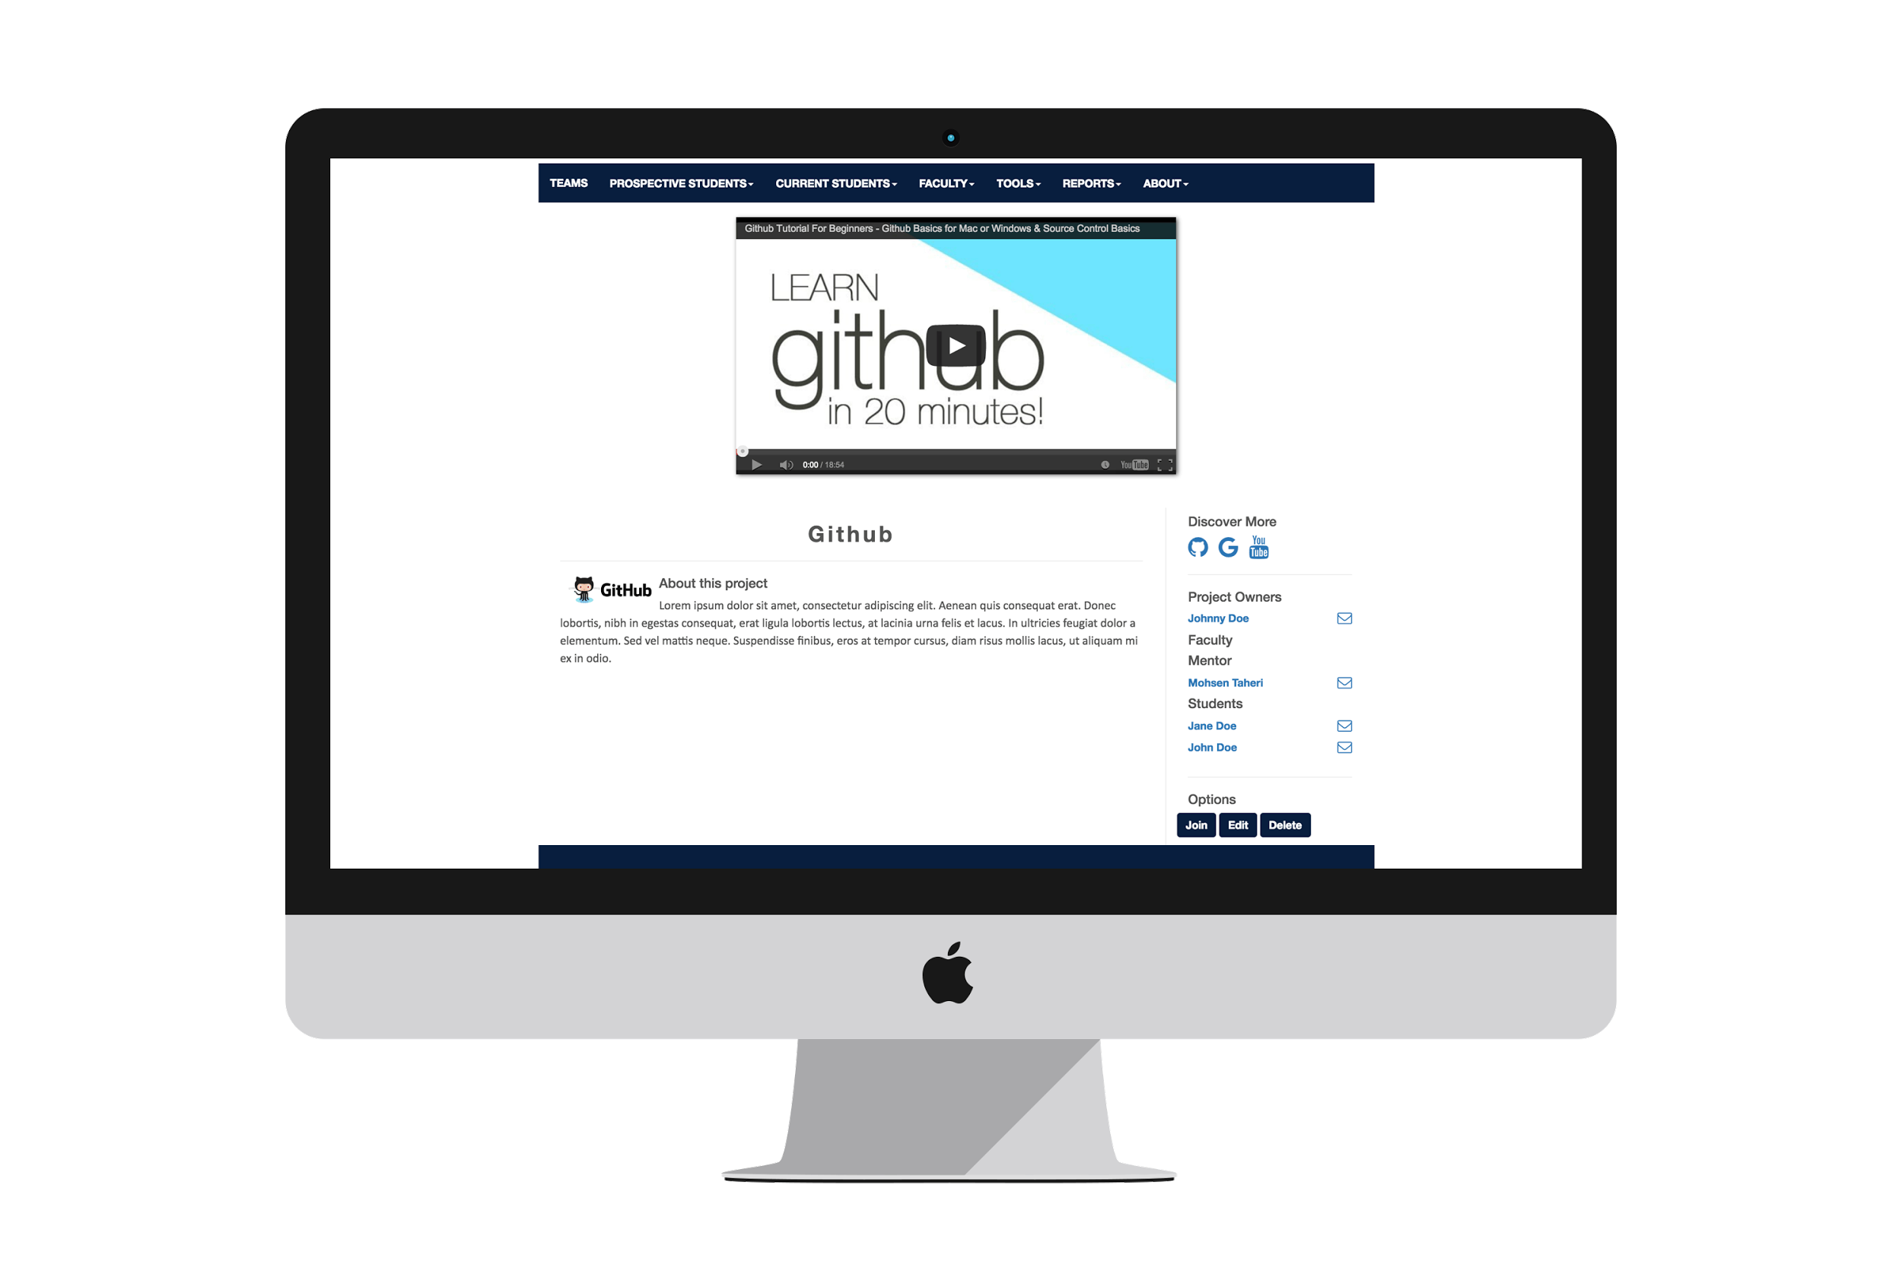
VIP TODAY

Slide 5
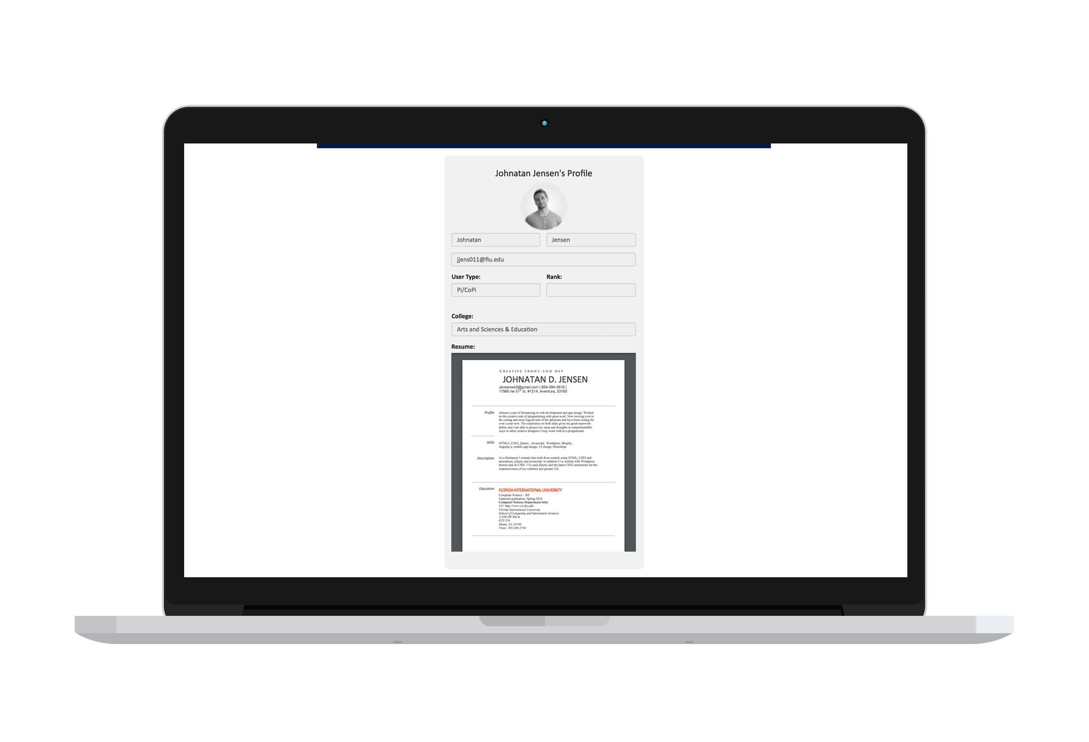
VIP TODAY

Slide 6
USE CASE DIAGRAM

Slide 7
MINIMAL CLASS DIAGRAM

Slide 8
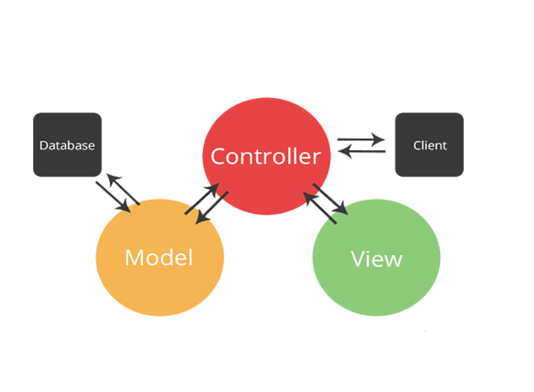

SYSTEM DESIGN: ARCHITECTURE
SOFTWARE
MVC
HARDWARE
CLIENT-SERVER

Slide 9
USER STORIES
Update projects page UI
Manage user profiles
Update projects overview UI
Create dynamic technical support form
Create “delete account” option
Change alert messages to pop-ups
Update websites fixed header
Tested and debugged main features

Slide 10
MANAGE USERS PROFILE
BEFORE: Profile with no purpose, no uniqueness, forever in database NOW: Deletable accounts, profile pictures and resumes for personalization

Slide 11
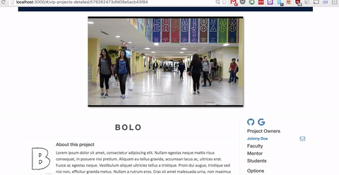
PERSONALIZED PROFILES

Slide 12
SEQUENCE DIAGRAM

Slide 13
UPDATE OVERVIEW PROJECTS UI
BEFORE: Blank squares and only project names, not mobile responsive NOW: Google style cards, description and owners for skimming, buttons to join or propose, default images and mobile responsive

Slide 14
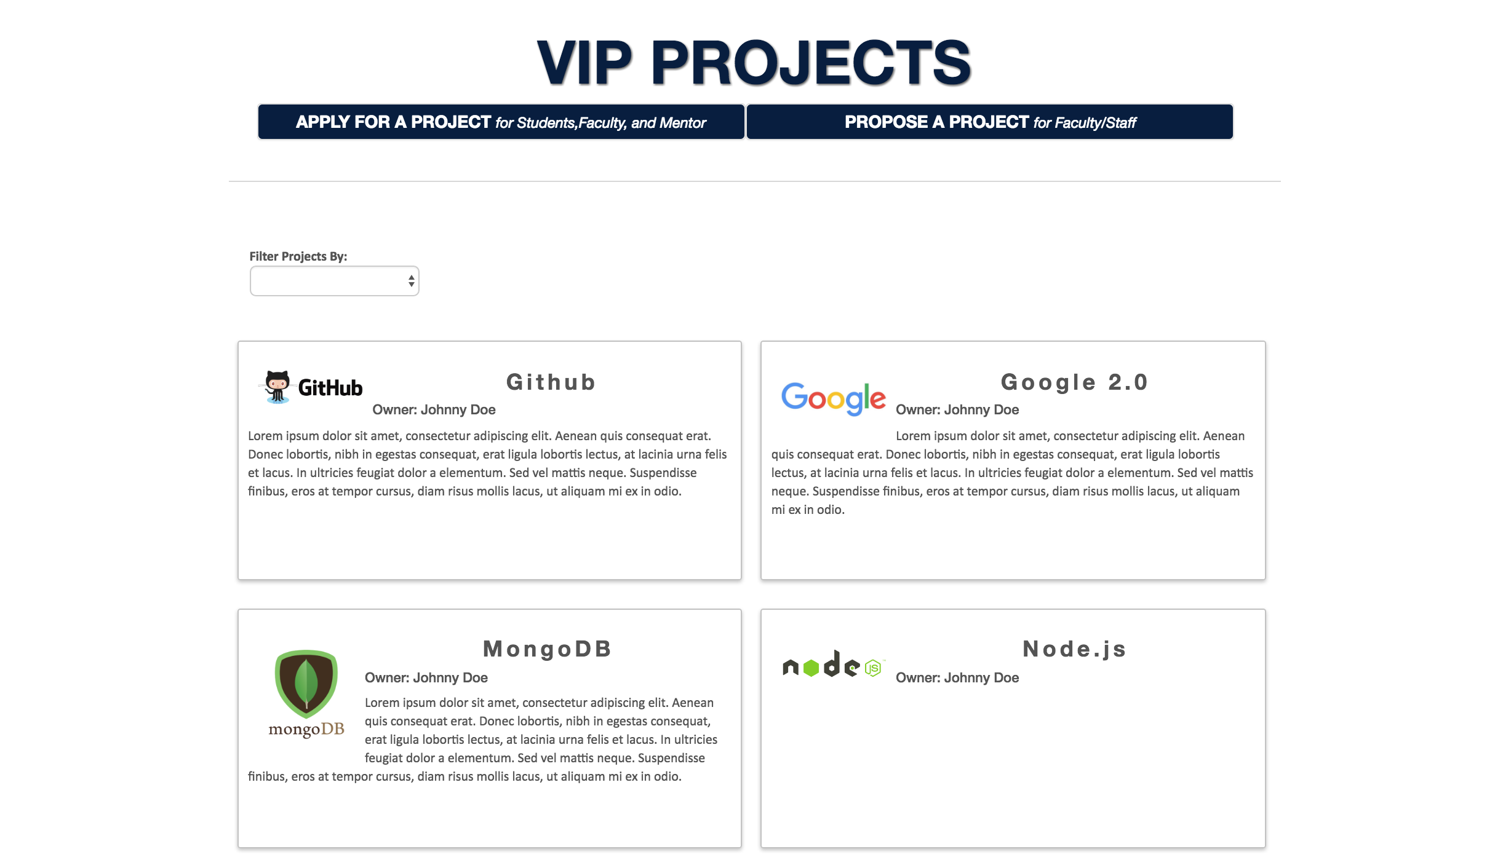
CARD BASED DESIGN

Slide 15
UPDATE PROJECTS UI
BEFORE: Small text, non-functional sidebar, strange HTML tag bug Now:
Github/Google drive links
View current codebase, opens in new tabs to not interfere
Video to introduce the projects, mobile friendly
Students on the sidebar currently working on the projects and the message icons
Profiles are now linked

Slide 16
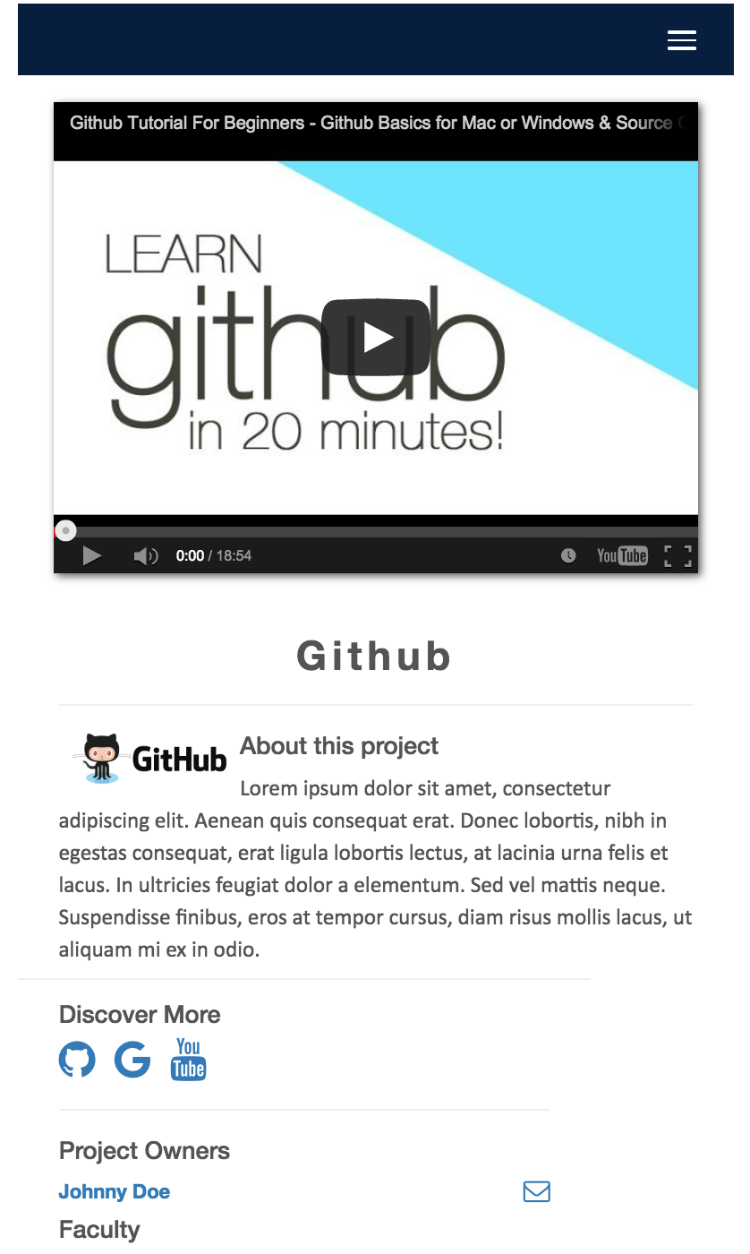
MINIMALIST FUNCTIONAL SIDEBAR

Slide 17
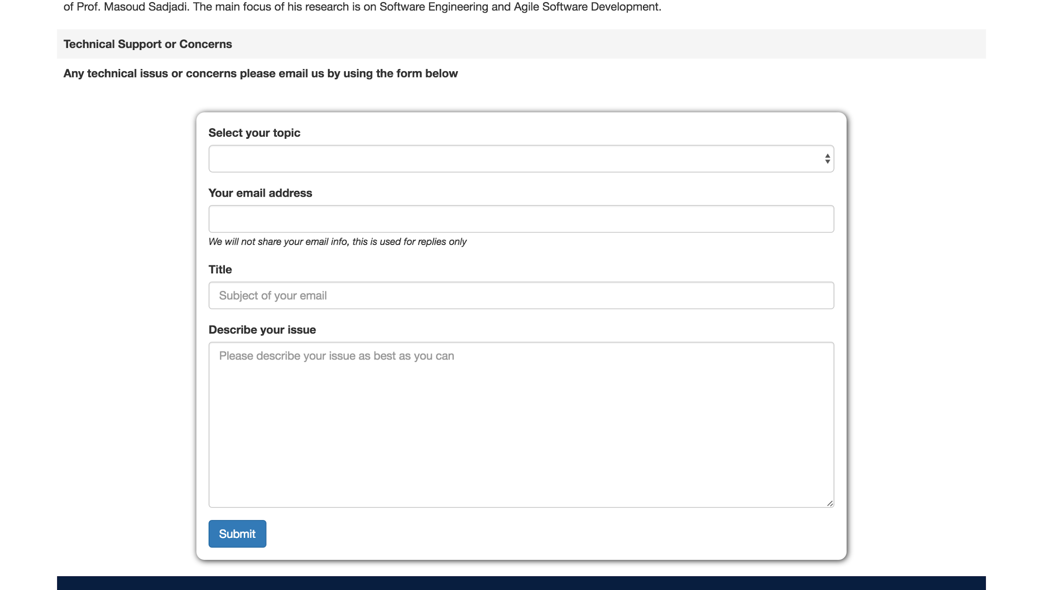
CREATE dynamic technical support form
BEFORE: Left on your own NOW: Based on topic selected, different appropriate users or faculty will be emailed about the question or issue
Full mobile responsiveness

Slide 18
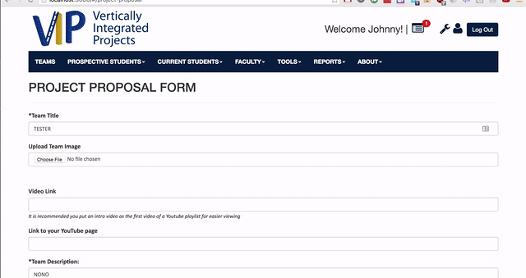
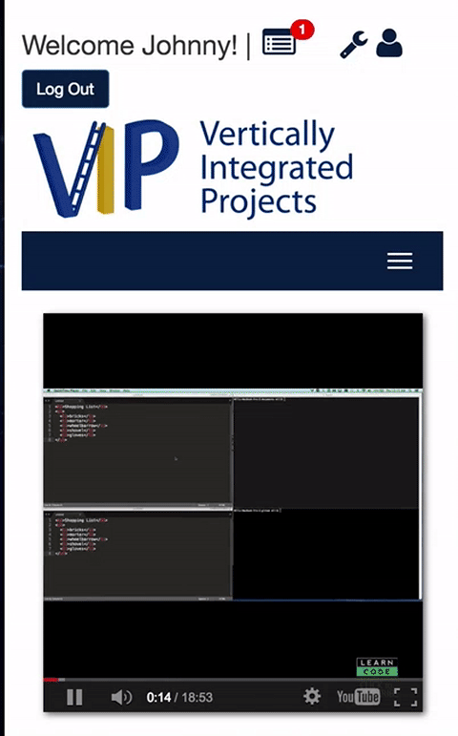
CHANGE alert messages to pop-ups
BEFORE: small ambiguous text boxes appeared below submit buttons NOW: responsive, mobile friendly, fluid and descriptive pop-ups, dynamic icons, easy to call global function

Slide 19
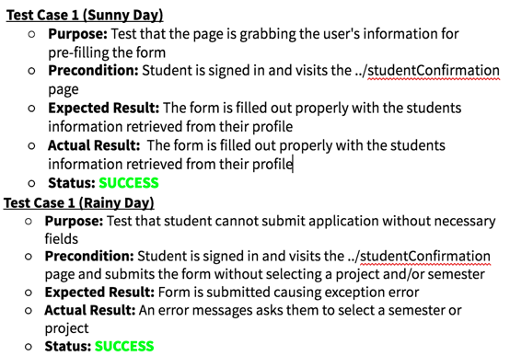
FEATURE DEPENDABILITY
The student application form grabs the user's information and displays it for verification that the info is correct. On the form it is necessary to select a project and semester before submission thus prompting the test cases I chose.

Slide 20


THANKS!
In short, the team behind VIP 3 has brought the web app to life and added it’s main functionalities. The experience is enjoyable and it will help connect faculty and students like never before
Any questions?
CONTACT | JJENS011@FIU.EDU

